Slide 1

Smart Borrow Tracker Project
Linlin Fan, NUID: 002067502 Kaiqing Yuan, NUID: 002308673 Ke Wang, NUID: 002316094

Slide 2
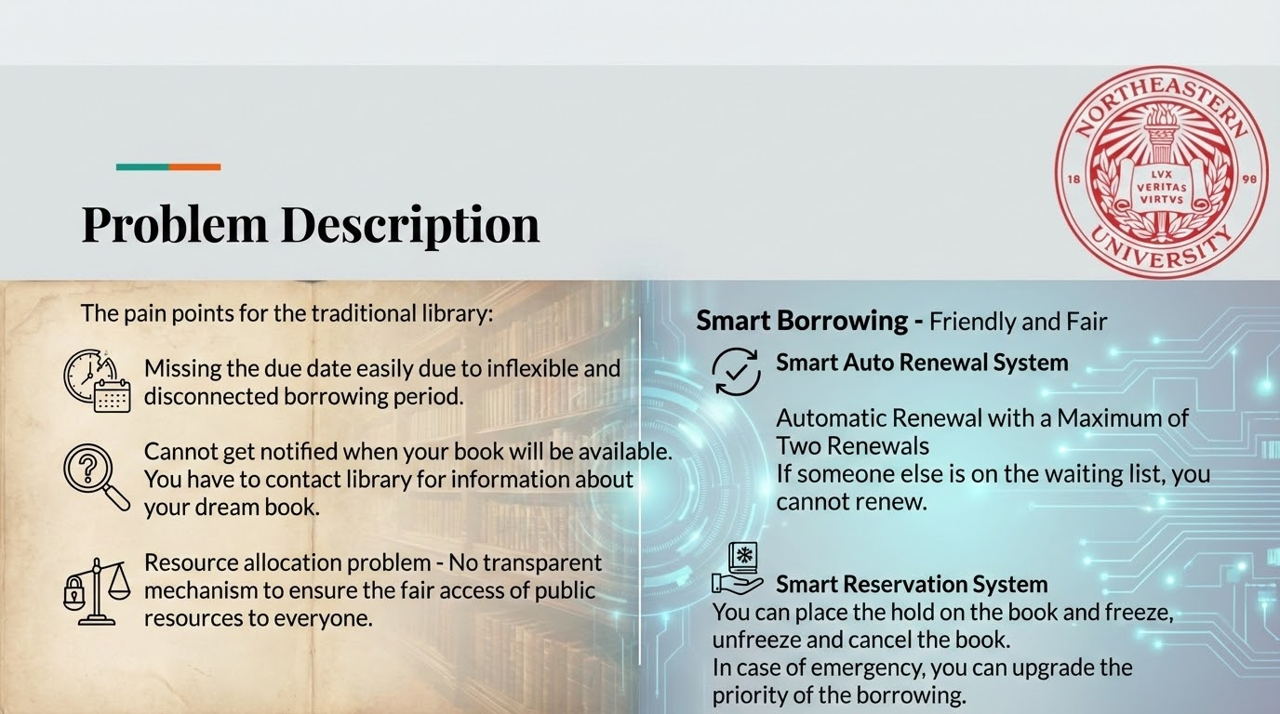

Slide 3
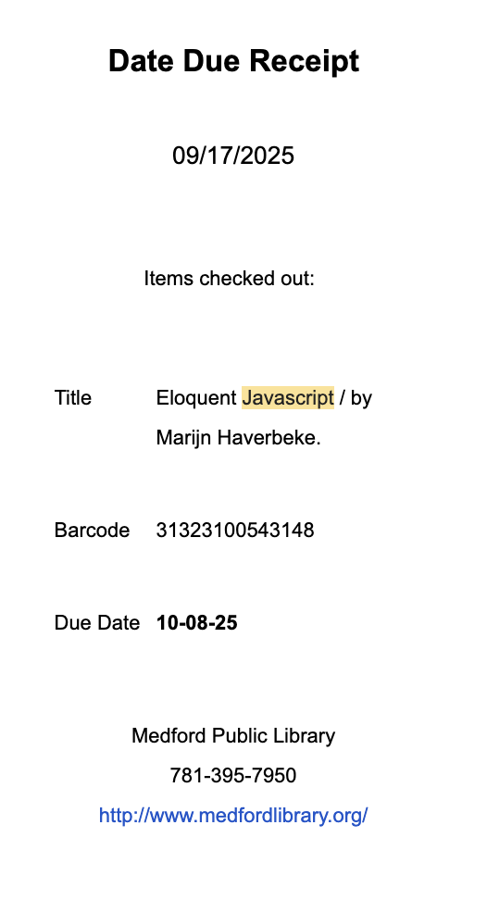
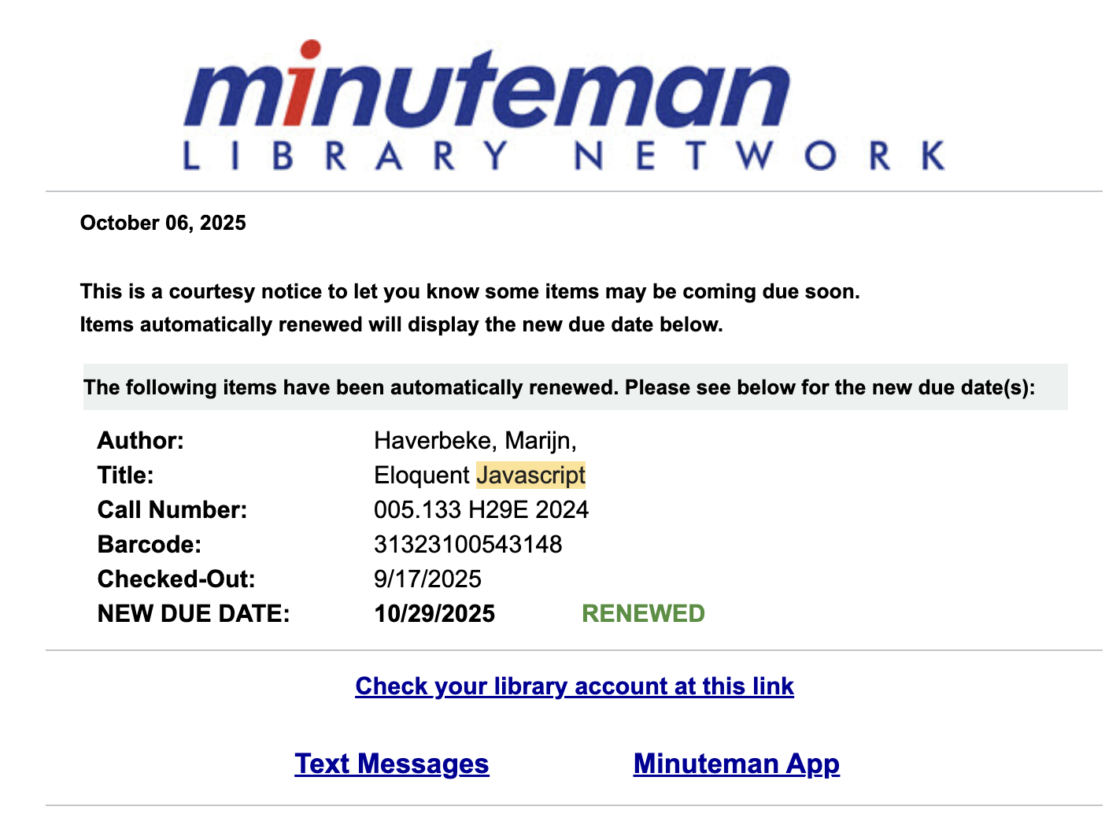
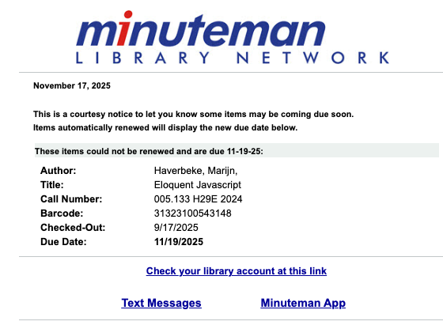
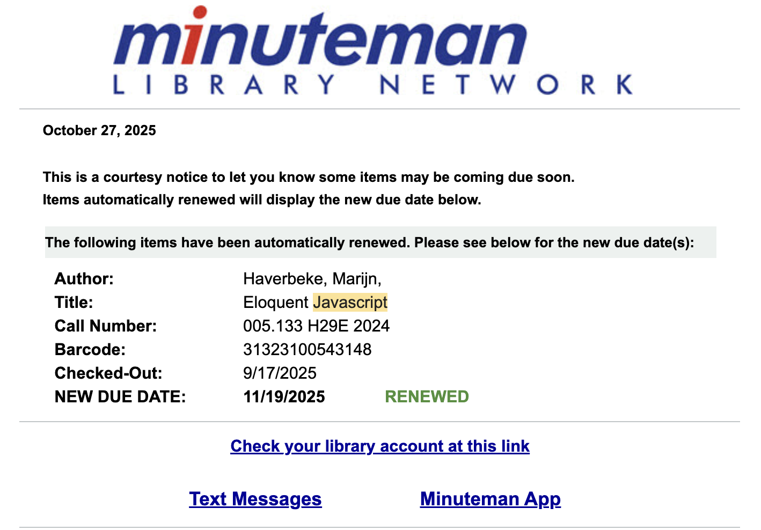
Analysis
Smart Renewal System
First Renewal
Second Renewal
Return Notification
First Due Date Receipt
If no one is on the waiting list before my due date: it can be automatically renewed for me
After two round renewal, I cannot renew this borrowing anymore: balance of public resource and private resource

Slide 4
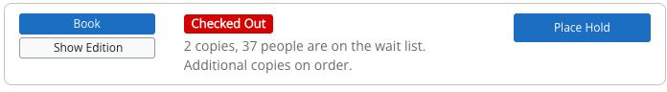
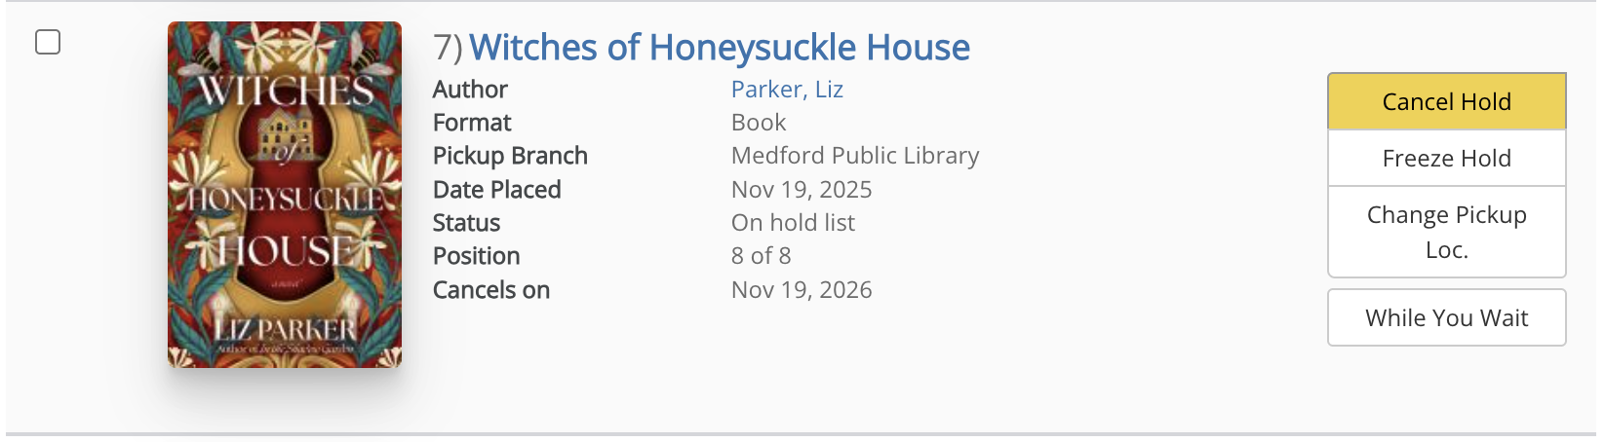
Smart Reservation System
Analysis
Place a hold
My Holds in My Account
Cancel Hold
Freeze Hold
Unfreeze Hold

Slide 5
My Smart System Required Topics
Library
Smart Borrow System
ADT
List
Deque & PriorityQueue
Map/Dictionary
Heap
Bag
Algorithms
Comparable
Sorting
Efficiency Of Algorithms
Recursion

Slide 6
Algorithm for smart borrowing
Analysis
Manage the Loan
Manage the Hold
Resizable ArrayBag
HeapPriorityQueue: auto renewal
ArrayDeque: FIFO
HashMap: Cancel or freeze

Slide 7
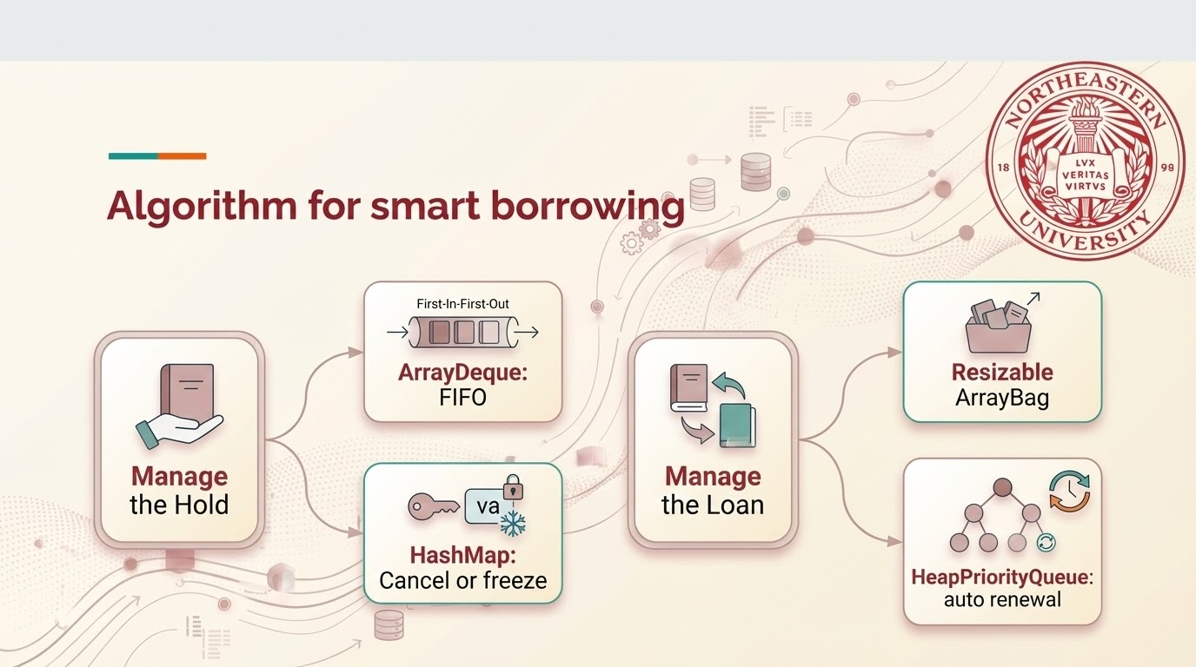

Slide 8
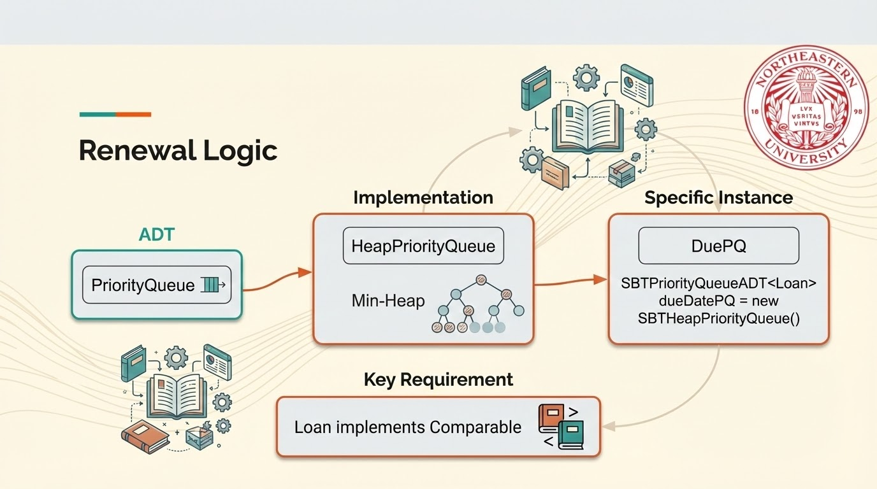

Slide 9
Analysis : Renewal Logic
Figure out the Decision by Comparing the efficiency
Heap = array-based tree
Why choose Heap instead of Array and Node: Efficiency of Algorithm
Heap array unsorted: Sorted Array linked List(unsorted)
Insert: O(log n) O(1) O(n) O(1)
Remove min/max: O(log n) O(n) O(1) O(n)
Peek: O(1)
Final Decision: Heap + PriorityQueue →HeapPriorityQueue

Slide 10
Solve the Challenge Step by Step by self-evaluation
Analysis : Reservation Logic
ArrayDeque for FIFO + HashMap for cancel and freeze
Step 1 Linked List → Linked Queue
For linked list, it normally use linked node with one pointer although linkedlist can also realize FIFO, add to the last is still O(n) although Remove from the first is O(1). While for linkedqueue, the both are O(1).
Compared with linked nodes with two pointer each, the linkedqueue, which stored two pointer in the queue, is more memory efficient.
Step 2 LinkedQueue → ArrayQueue
ArrayDeque (Array Double-Ended Queue) is generally faster and more memory-efficient
Step 3 Arrayque → ArrayQueue
Dequeue has more methods than Queue, Queue can only implement FIFO and cannot support queue head insertion.

Slide 11
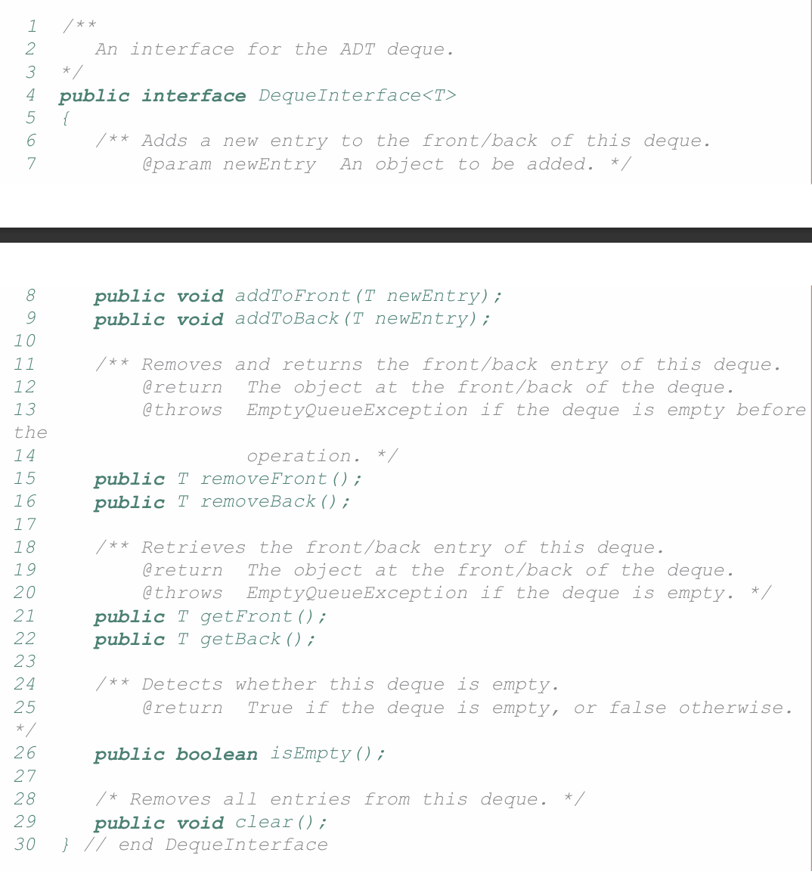
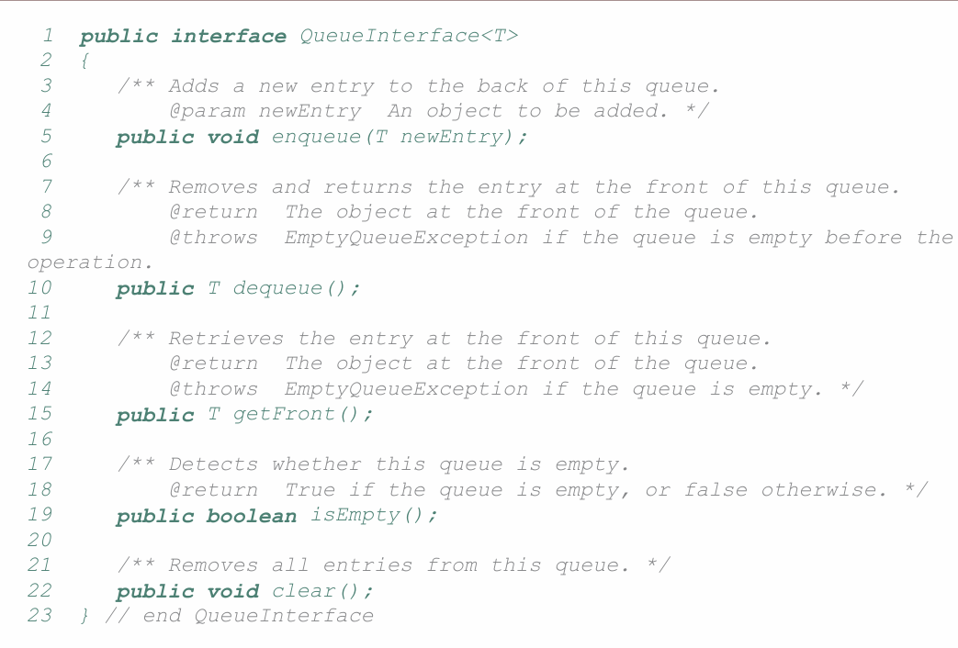
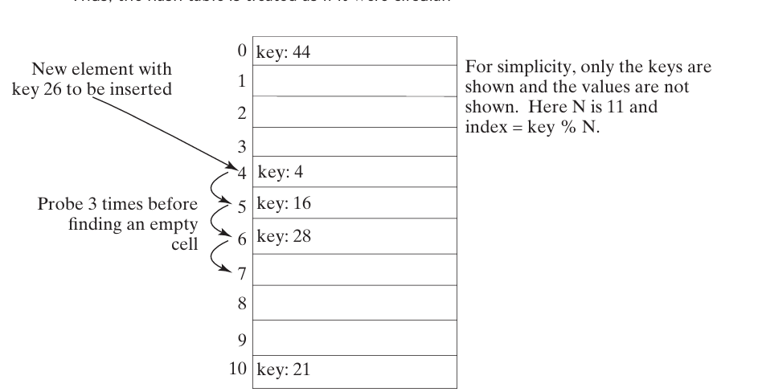
Analysis : Reservation Logic
ArrayDeque for FIFO + HashMap for cancel and freeze
Linear Probing + Open address to solve conflict in implementing
Map/Dictionary ADT

Slide 12
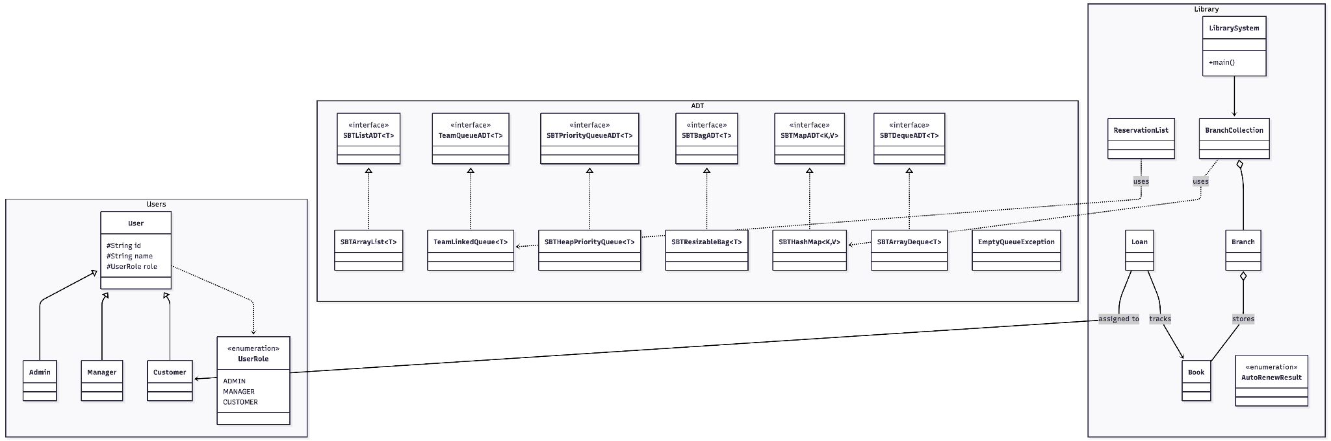
UML Chart
Design
Linkedqueue is the previous design. Currently Arraydeque is connected with reservation list

Slide 13
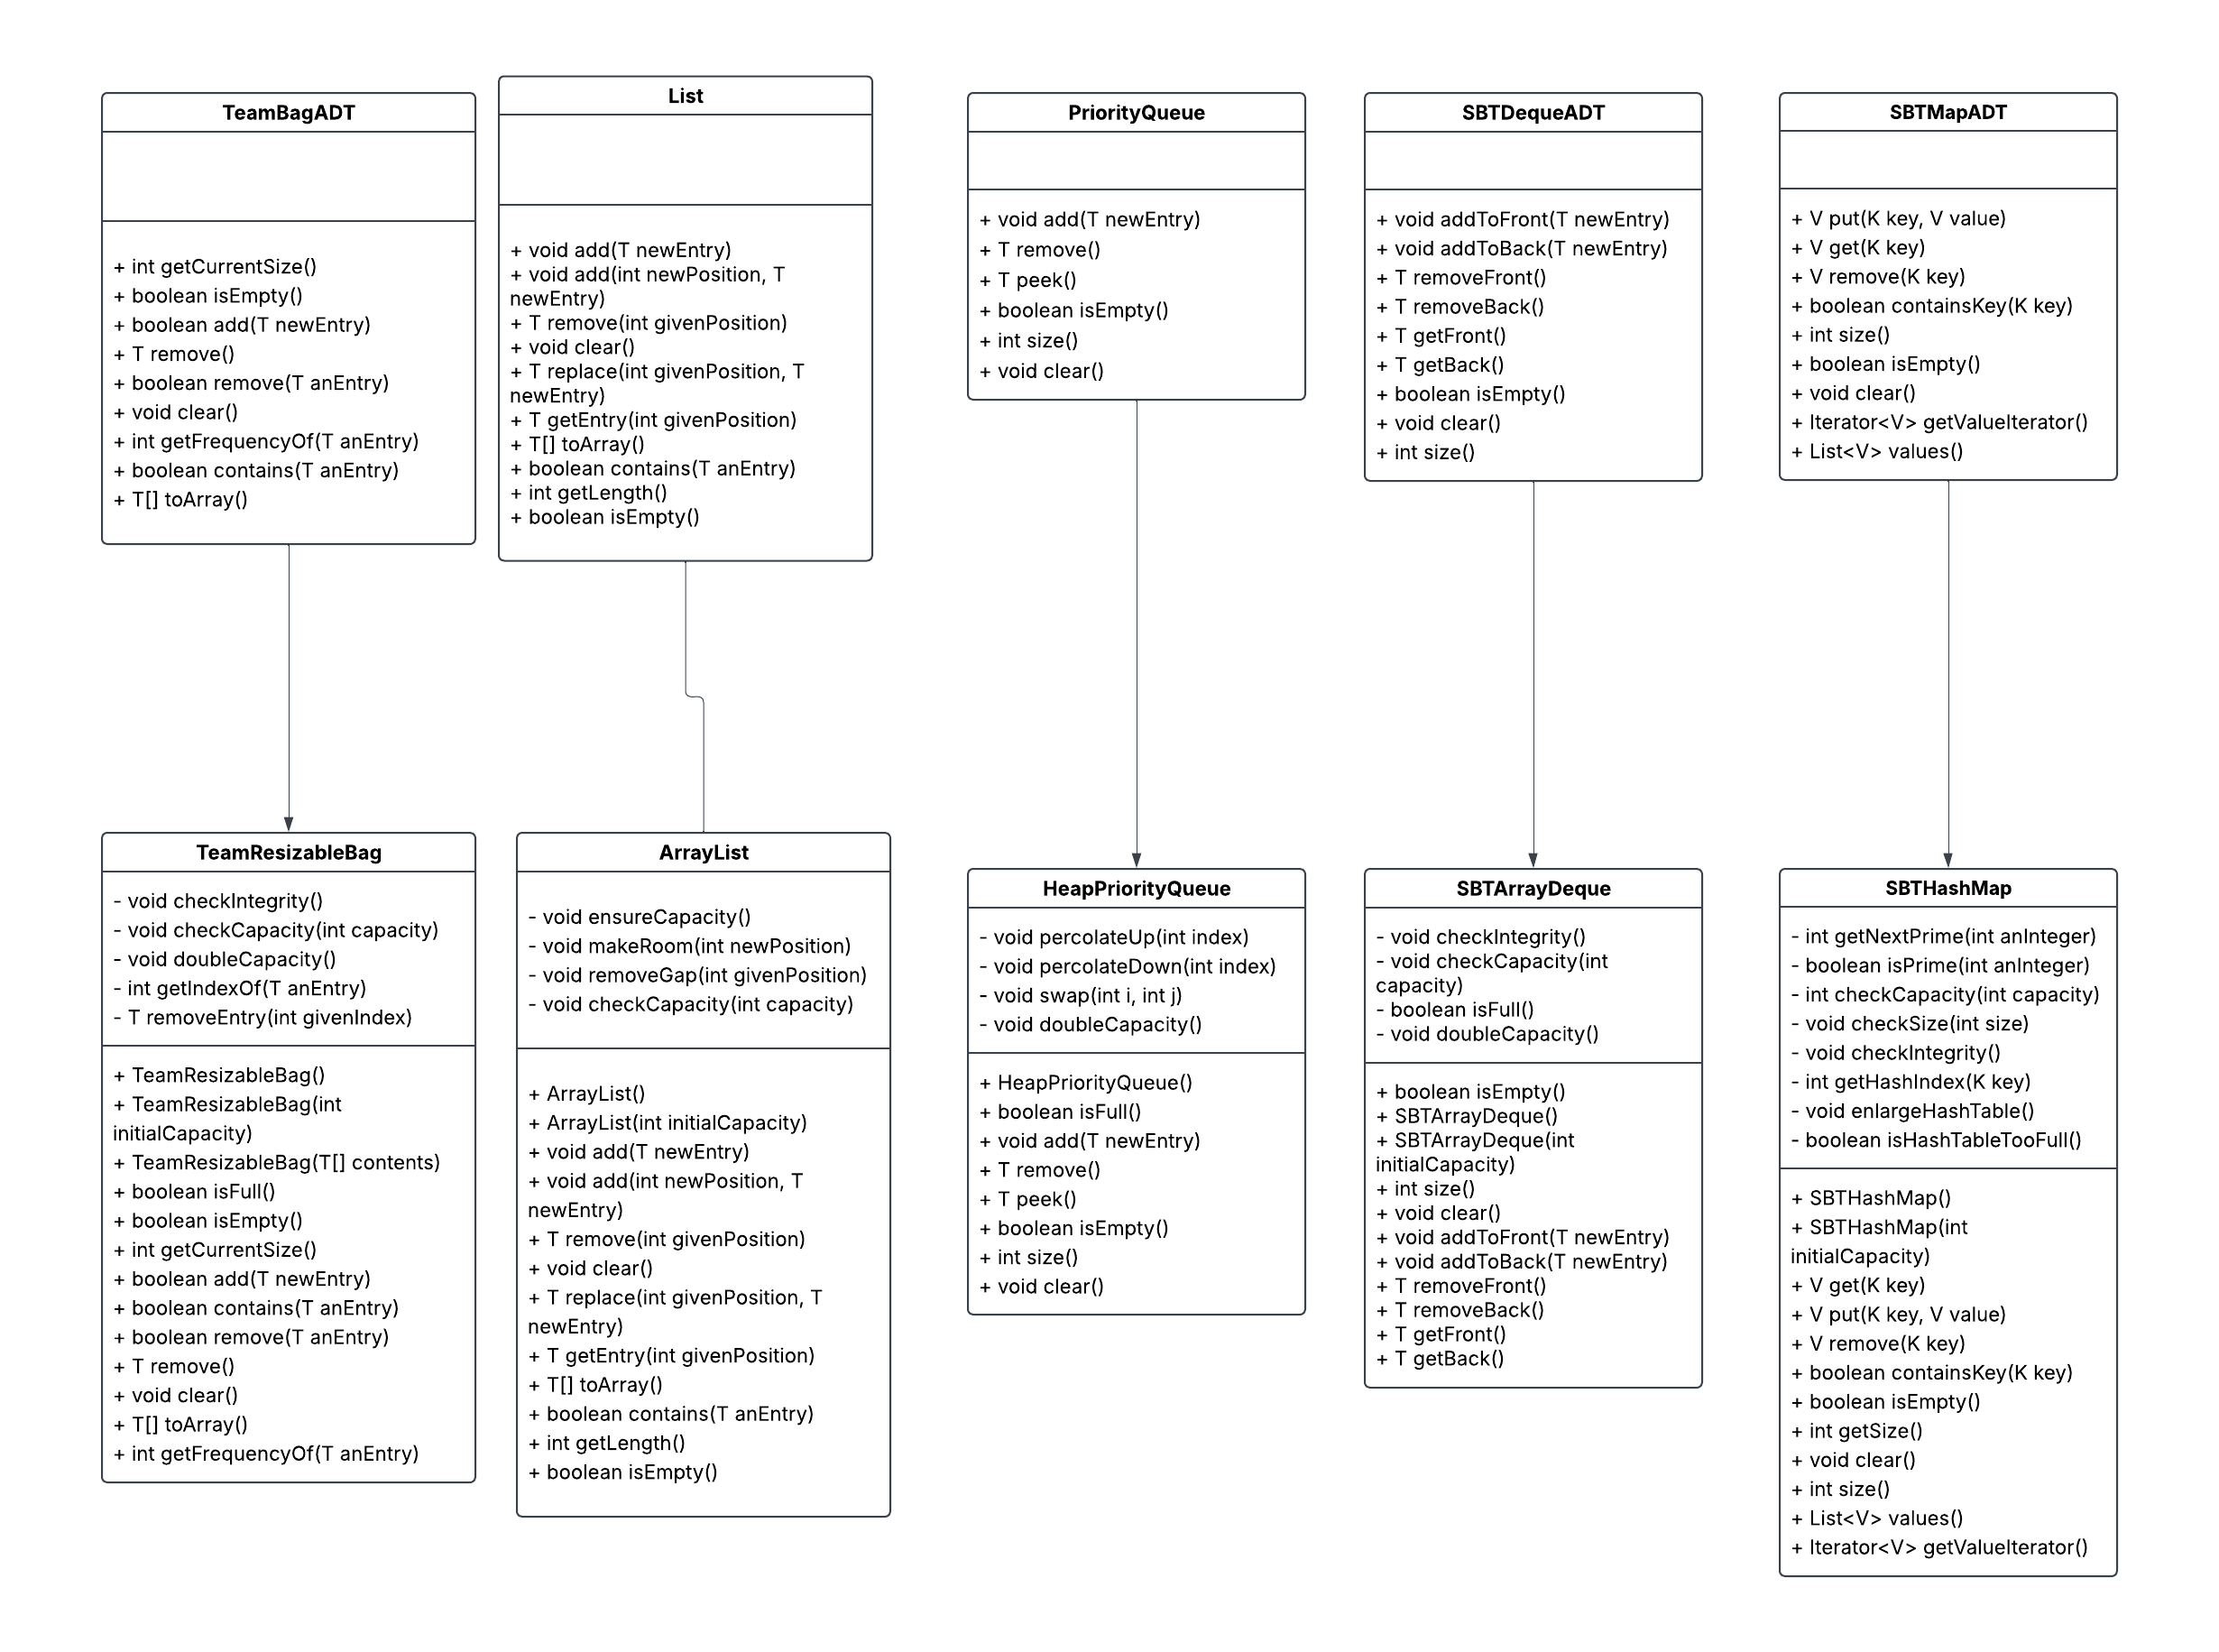
ADT &
its implementation
Design

Slide 14
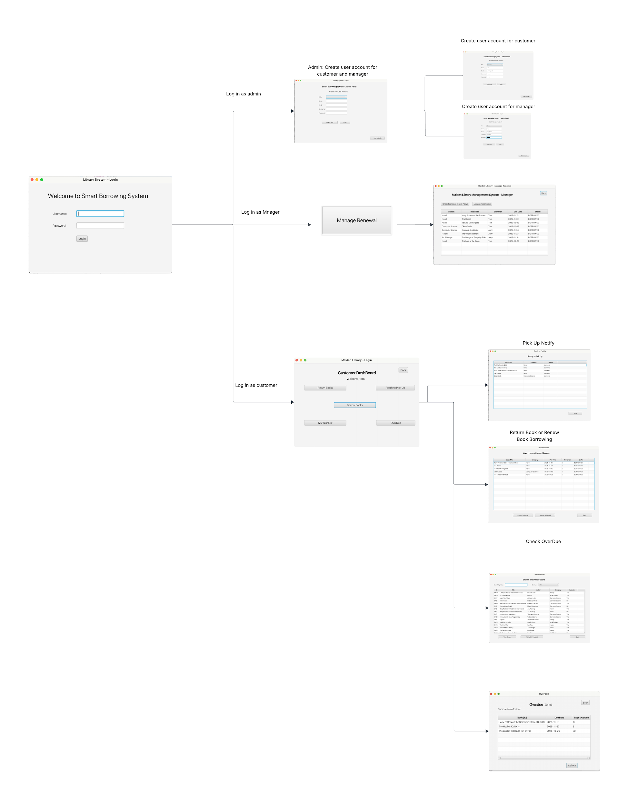
Results
11 UI with 3 roles User Flower Chart: Admin; Customer; Manager
LucidChart

Slide 15
User Study
Pros
The app can work well without the stuck points;
The customer dashboard is very easy to understand, in line with natural logic;
It’s good that I can see the waitlist, cancel the hold and frozen and unfreeze the hold. These functions are very user friendly
Cons
Although I know the size of the waiting list but I do not know how many people are in front of me;
Missing loading status and progress prompts;
Error message is not friendly enough.

Slide 16
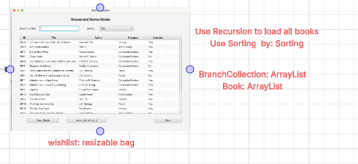
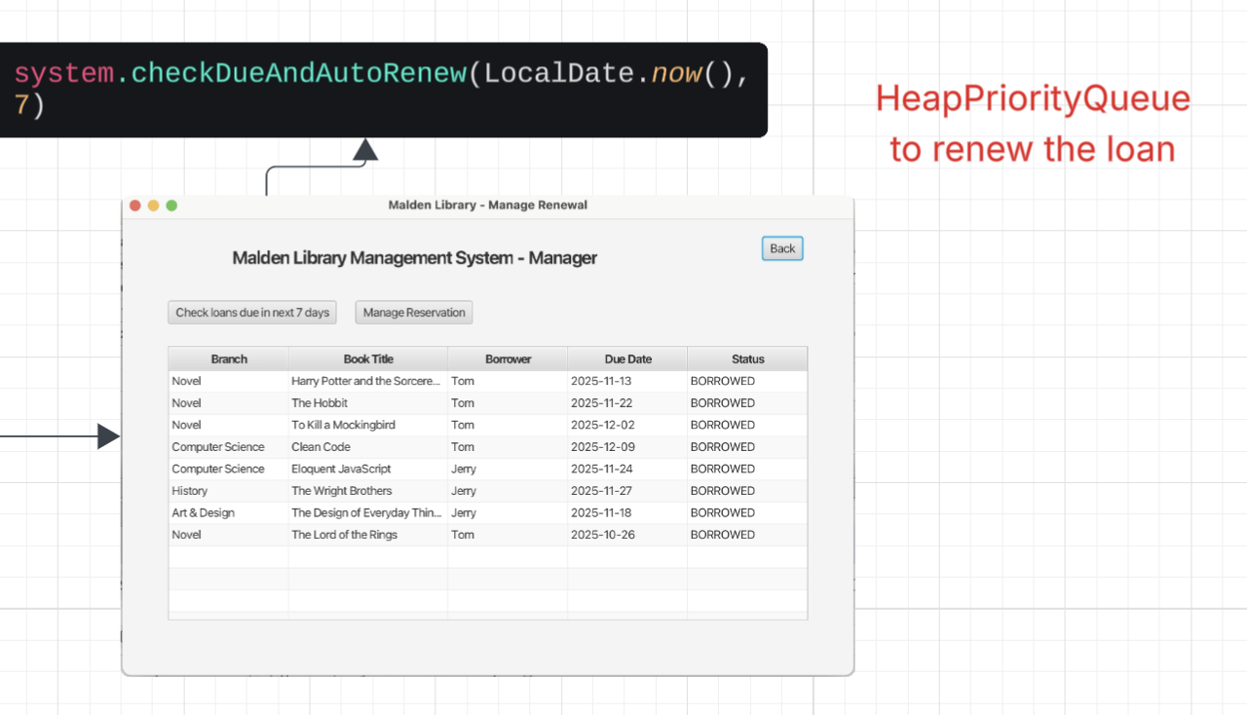
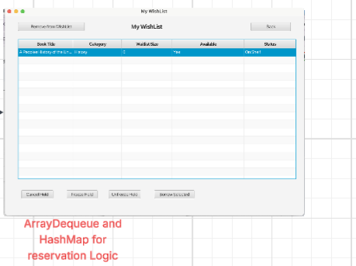
Custom ADTs & Data Structures – Usage Overview

Slide 17
Implementation
We use ScreenBuilder and JavaFX to add and modify UI in Eclipse
We add CSV file for the data.
We use UML diagram to record the class and UI Panel and the methods behind the button
We use github to track all our commit version and merging work into a complete one.

Slide 18
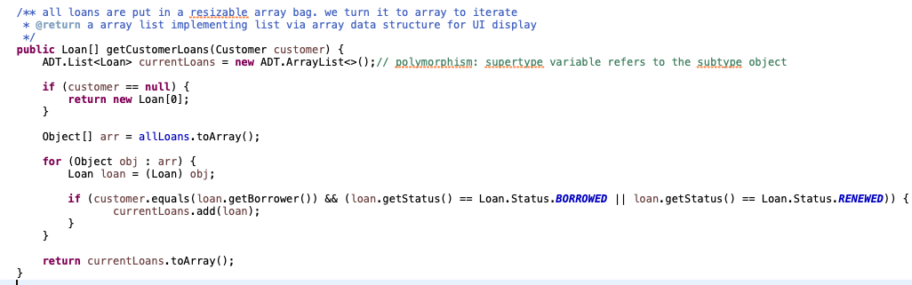
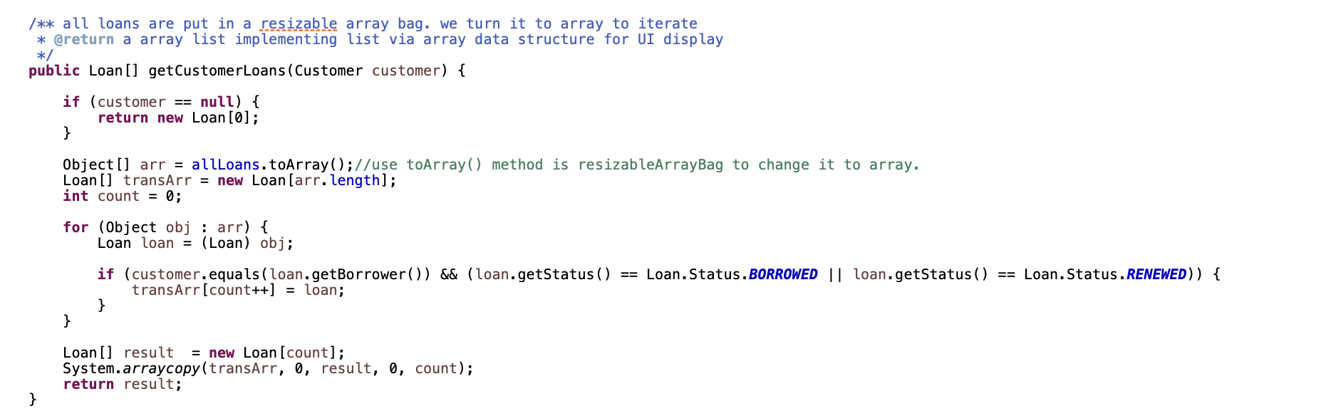
Implementation (Challenge)
At the beginning we plan to use API, but sooner we find out that we didn’t have the part of adding books in the app, it is easier to use text at the beginning.We finally decided to use CSV file, which is used to populate the real book and loan data into our system. When importing the CSV database and using the screenbuild to do the UI, we find it difficult because it is the first time we apply these two tools.
When trying to add and use the screen builder in the eclipse, linlin met some challenges since she used screenbuilder for the first time. She found if she only add button without action logic, it will bring error. The other UI error may also happen when the file name does not match.
When trying to putting the backend logic behind button, linlin met some challenges like she wanted to add this function in backend so that front end can directly use it.
this function will bring an error because currentLoabs.toArray() does not return an specific array just Object array
After Improvement

Slide 19
Discussion(Reflection)
Start to use the Github earlier.
We should use ADT based on the functions and demands instead of realize them for realization purpose
Get familiar with Javafx earlier
Get more familiar with HashMap, HeapPriorityQueue and other general concepts
Power of Software: ensure flexibility and ensures fairness. Algorithm is everywhere in life.
Program to interface, not an implementation.
Comments make the abstract concepts easier.

Slide 20
Conclusions (and Future Work)
Debugging the UI
We may add some real scenario for an unavailable book such as in transmission, on order, and so on.
Missing data persistence. All data only exists in memory and is lost when the program is closed. (Add file persistence (JSON/XML/database). Implement save() and load() methods. Automatically save regularly)
Ensure the logic behind every button can use the backend code instead of programming in UI.
Improved logic
Analyze the efficiency of the code. Make sure to optimize the whole system to its best time efficiency.

Slide 21
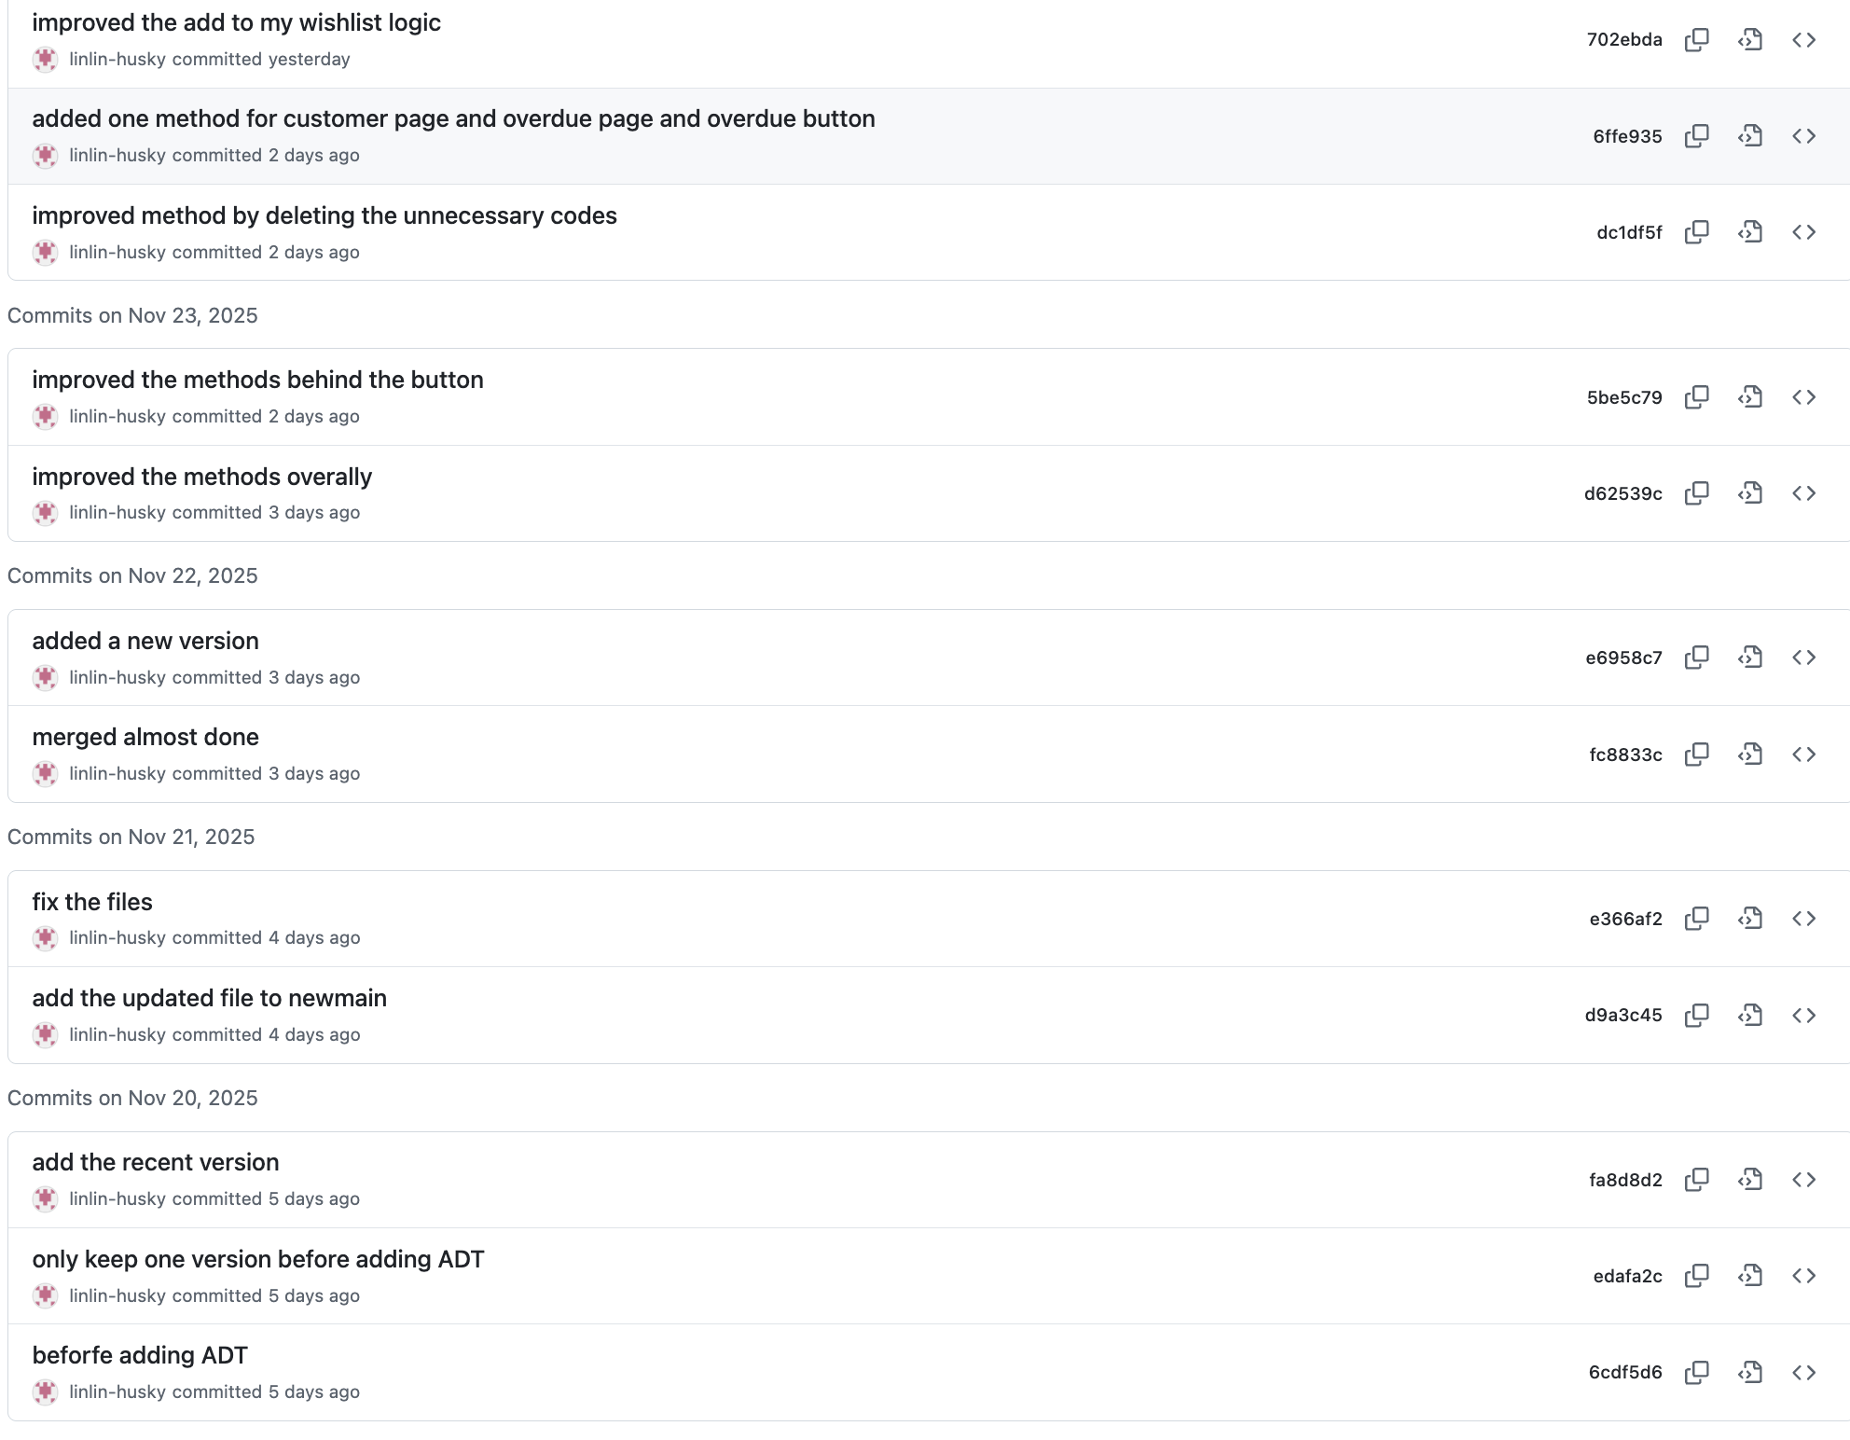
Job Division
Linlin: 1. Bring Smart Borrowing System idea from real life experience. Write down the problem description and analysis concerning this problem.
2. Trying to improve the code by adding some well-designed methods in backend. So the front end can directly use it. 3. Design Bag and resizable bag, priorityQueue and HeapPriorityQueue, designed deque and Arraydeque; updated MapADT with improved design and methods and designed Hashmap. Add comments to files under ADT folder for better understanding. 4. Add efficiency of algorithm in analysis and add recursion;
5. Flower Chart 6. High-Level UML diagram. 7. Write most contents of PPT slides; Write code in backend; 8.use JavaFX and screenbuilder to create UI and modify UI, 9.Add comments for ADT and its implementation related classes. Add csv file as database file 10. Based on the feedback from TA, I added the error messages and improved the UI with css.

Slide 22
Job Division
Kaiqing Yuan
• Designed core data structures (custom ArrayList, HashMap, HeapPriorityQueue, LinkedQueue, Bag) and clarified their roles.
• Built the main library business logic: borrow, return, reserve, waiting list, auto-renew, and due-date checking via a priority queue.
• Implemented fair reservation and renewal behavior to address traditional library issues (fixed loan period, unfair renewals, slow due checks).
• Designed the initial UI flow for all roles (Admin / Manager / Customer) and the main screens (login, dashboards, management pages).
• Improved customer experience screens, including a structured Overdue view and “ready to pick up” integration with holds.
• Debugged and wired JavaFX/FXML (controllers, resource paths, back buttons, imports) so the whole system runs end-to-end.
• Delivered a first complete, runnable library prototype; later changes were refinements based on this working core.
Ke Wang :
ADT: Map, Hashmap, UML, Code decoration

Slide 23
Q&A

Slide 24
Thank you

